Slide 1
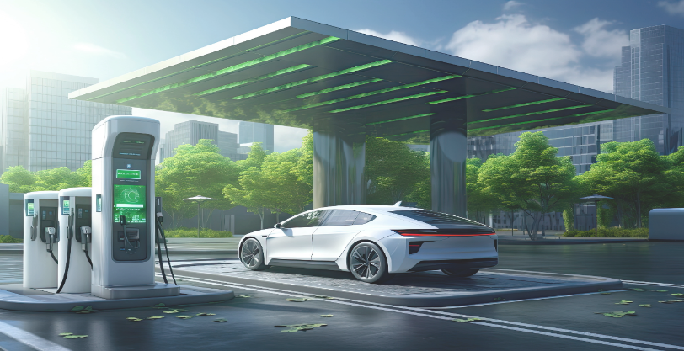
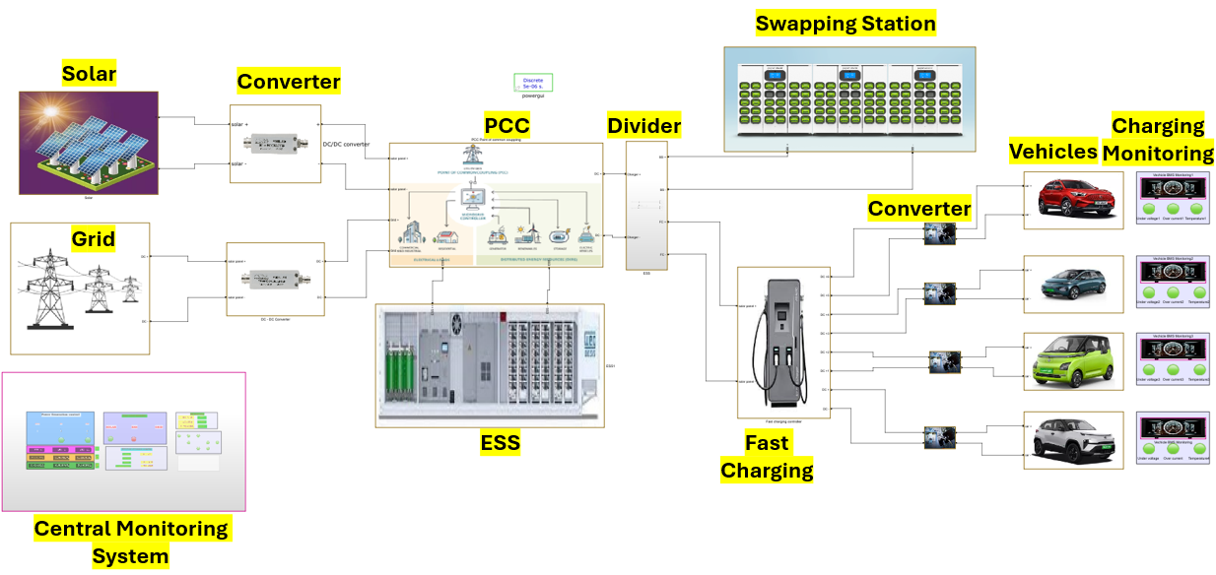
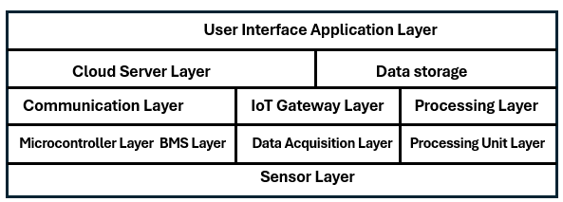
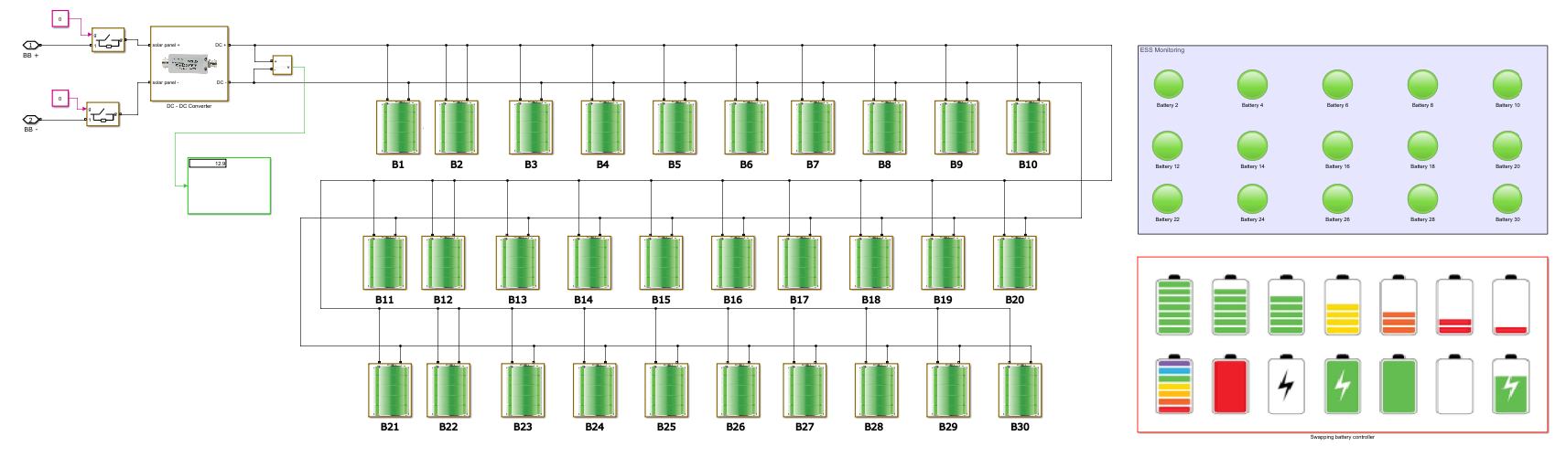
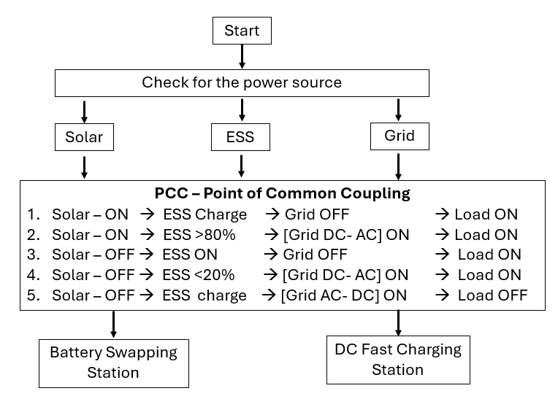
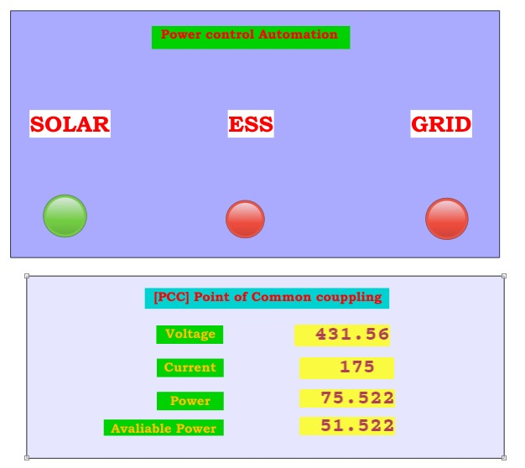
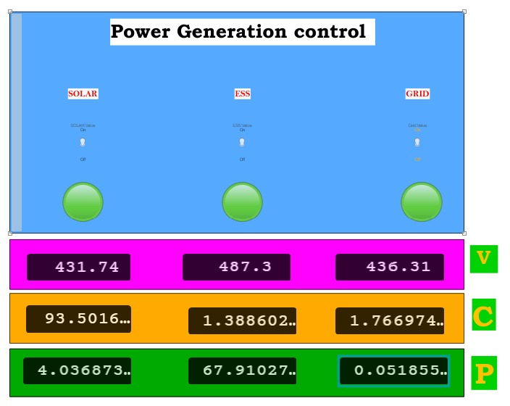
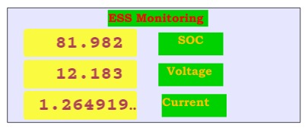

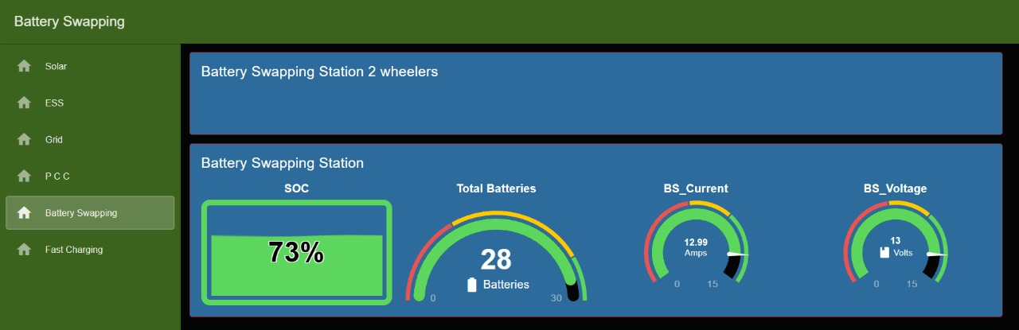
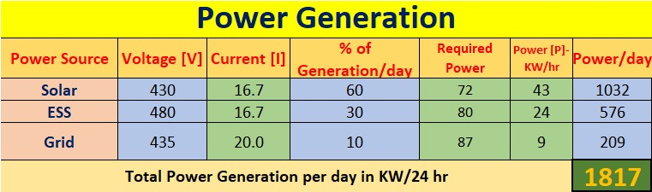
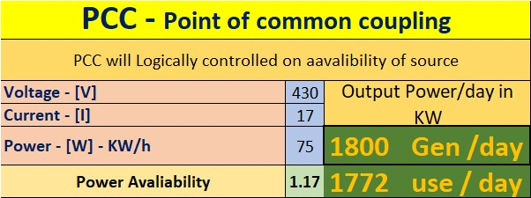
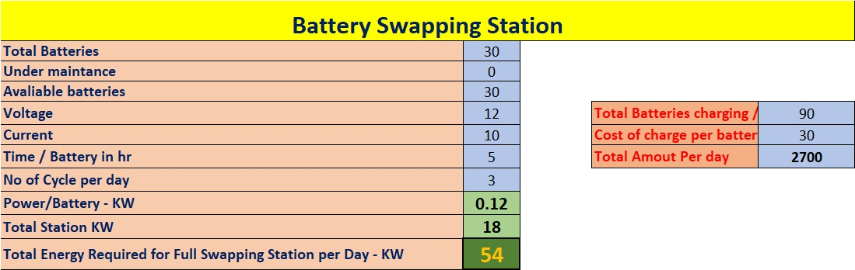
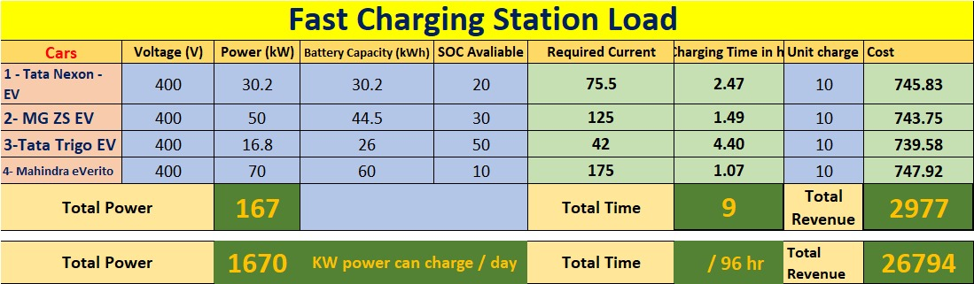
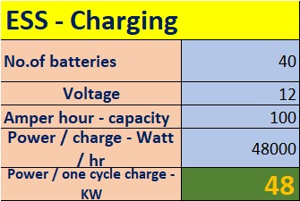
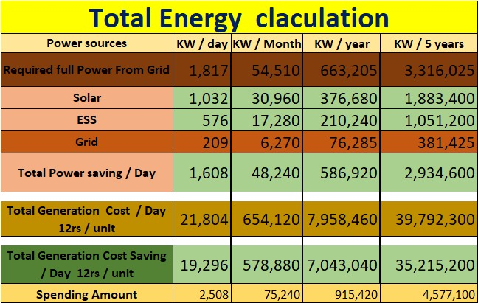
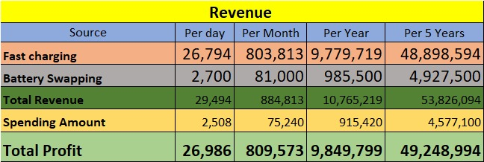
Design of IOT Architecture for Battery Charging Management System
Battery Swapping station and EV Charging Infrastructure
Engineering & Technology
Abstract
Methodology
Simulation work
Rapid growing of electric vehicle (EV) adoption faces challenges such as range anxiety and inconsistent charging infrastructure, which can be effectively addressed through an IoT-based architecture that offers real-time monitoring, predictive analytics, and mobile charging units, ultimately enhancing user experience, optimizing energy management, and promoting sustainable energy solutions for a cleaner future.
IoT Five-Layered Architecture
User Interface Application Layer
Cloud Server and Data Storage
Communication Layer
Microcontroller Layer
Sensor Layer.
Point of Common Coupling (PCC)
Combines solar power, ESS, and grid power for Integration and Automation.
Algorithms
MPPT (Maximum Power Point Tracking) Algorithm:
Optimizes solar panel output by continuously adjusting the operating point to maximize energy capture under varying conditions.
Battery Swapping Station Algorithm:
Manages logistics and scheduling for battery swaps, optimizing inventory and availability of charged batteries to improve service efficiency.
Vehicle Charging Control Calculation:
Calculates optimal charging rates based on battery state-of-charge (SOC) and user demand, ensuring safe and efficient charging.
Safety and Blast Condition Prediction using ML:
Utilizes machine learning models to analyze historical data and predict potential safety hazards in battery charging environments, enabling proactive risk management.
Cloud Integration AWS
Secured MQTT Protocol:
  Utilizes MQTT for secure and
  Efficient communication between IoT devices and the cloud.
Data Storage:
  S3 Bucket and durable storage solutions.
  Stores collected data in Amazon S3 for scalable.
Email Alerts:
  Implements automated email notifications for critical events or alerts related to battery charging management.
Data Visualization:
  Provides real-time data visualization dashboards to monitor charging status and performance metrics.
Introduction
Growing Demand for Charging Infrastructure:
The rapid increase in electric vehicle (EV) sales is creating a pressing need for more efficient and accessible charging stations to alleviate range anxiety among users.
Integration of Renewable Energy:
There is a critical requirement for sustainable charging solutions that incorporate renewable energy sources, such as solar power, to align with environmental sustainability goals.
Cost Reduction and Innovation:
The necessity to reduce operational costs in charging management is driving the adoption of innovative IoT technologies aimed at optimizing battery management and enhancing overall efficiency.
Real Time Monitoring
Problem Statement
Demand of Charging Infrastructure Expansion
Grid Load Disturbances
High Installation and Operational Costs
Inefficient Load Management
Limited Remote Monitoring
Data Visualization
Objectives
Develop an IoT-based architecture for optimized battery charging management.
Incorporate real-time data monitoring and predictive analytics.
Enhance operational cost efficiency by up to 88.5%.
Promote sustainable energy integration through solar and ESS.
Estimated Energy and Cost calculation
Motivation
The rapid growth of electric vehicles (EVs) necessitates a robust and efficient charging infrastructure that integrates renewable energy sources like solar power for environmental sustainability while driving innovation in IoT-based battery management technologies to reduce operational costs.
Project Novelty
Innovative IOT 5 layered Architecture.
Integration of multiple energy sources.
Central monitoring and controlling.
Real-Time data processing and user interface.
Cloud connectivity.
Cost efficiency model.
Scalability and Adaptability.
Portable charging station.
Conclusion
The proposed IoT-based architecture addresses critical challenges in EV charging infrastructure by enhancing efficiency, integrating renewable energy, and providing real-time monitoring.
This innovation paves the way for sustainable transportation and significant cost savings.

